Slide 1

Career Recommendation System
Team 2
Anusha Boppa
Sunil Kumar Bandili
TharunTeja Bavandlapelli
Venkateswarlu Jampani
SairamlaxmanReddy Burugapalli
Final Technical Presentation
Presented By

Slide 2
Intended User of the Application
User Profile: Career Services Analyst or Career Counselor
Organizational Role: Mid-level, reporting to Director of Career Services
Use Context: Offers job search and career growth guidance to students/employees
Thought Process: Focused on professionals guiding multiple users; real job descriptions and academic settings informed this decision
User’s Knowledge Base: Familiar with basic employability metrics (skills, industries, salaries, trends)

Slide 3
Decision-Making Needs of the User
Core Responsibilities:
Personalized Career Advising
Workforce Readiness Analysis
Institutional Placement Reporting
How Dashboard Helps:
Filters by experience, industry, salary
Skill gap visualization
Aggregated placement insights
Challenges & Curriculum Links:
Balancing individual vs institutional data → Solved using filters, calculated columns (Applied Analytics)
Determining useful metrics → Solved through prototyping and Data Visualization

Slide 4
Data Validation and Preparation – Part 1
Tables Used:
postings.csv – job_id, title, location, remote_allowed
job_skills.csv – skill_abr
salaries.csv – med_salary, min_salary, max_salary
companies.csv – company_id, size
job_industries.csv – job_id, industry_id
employee_counts.csv – employee size over time
How Tables Were Identified: Based on project charter + functional requirements

Slide 5
Data Validation and Preparation – Part 2
Validation Performed:
Cleaned missing/null values
Ensured foreign key consistency (e.g., job_id matches)
Converted Unix time to readable date
Checked salary ranges for outliers
Data Transformations:
New column: "Remote Option" from remote_allowed
Skill frequency counts
Date conversion from listed_time
Course Help: Information Systems, Applied Analytics

Slide 6
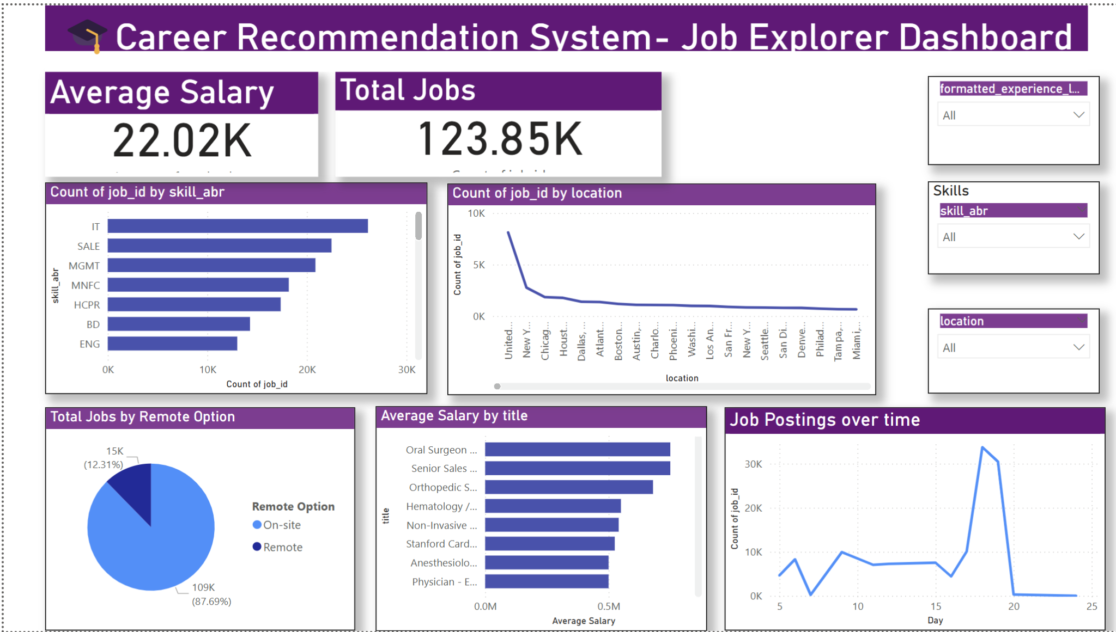
UI Design – Job Explorer Page
Contents: Avg Salary, Total Jobs, Skills Chart, Salary by Title, Location Distribution
User Interactions: Slicers (title, location, experience level)
Purpose: Provides snapshot for advising and exploration

Slide 7
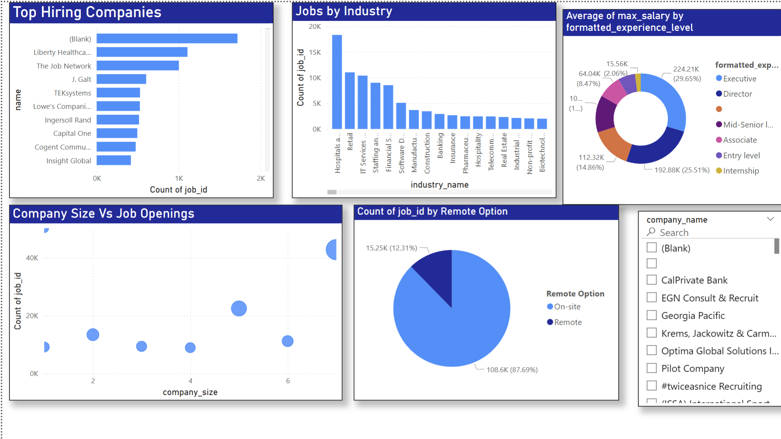
UI Design – Company & Industry Page
Contents:
Top Hiring Companies
Jobs by Industry
Avg Salary by Experience
Company Size vs Openings (Bubble)
Purpose: Compare demand across industries and companies
Interaction: Company filter updates skill chart dynamically

Slide 8
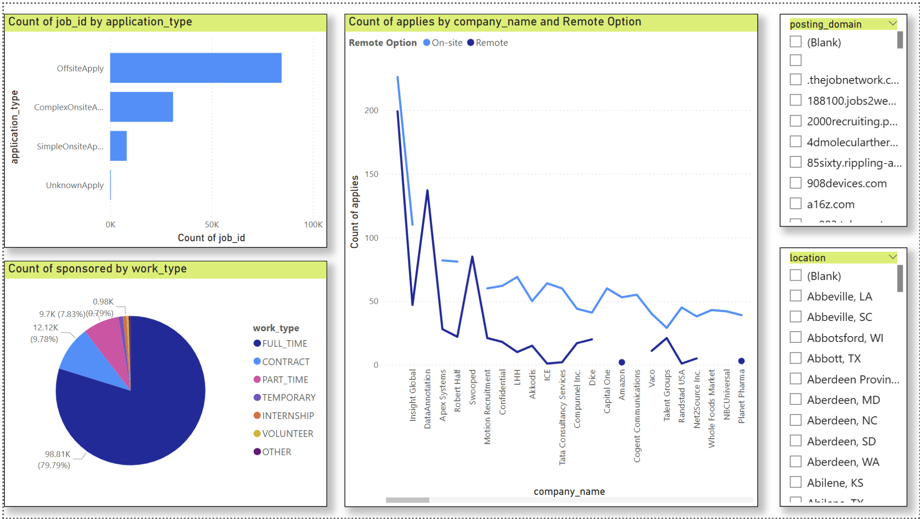
UI Design – Application & Work Type Page
Contents: Work types, application types, applies by company vs remote
Purpose: Understand user behavior & job types
Interaction: Filters by domain, company, experience level

Slide 9
Validation & Verification
Traceability Matrix Basis: Each visual mapped to user requirement
Verification Steps:
Manual record checking
Output cross-referencing (e.g., KPI validation)
Filter responsiveness testing
Courses Linked: Data Visualization, Information Retrieval, Applied Analytics
Outcome: Confirmed application addresses job trend analysis, salary insights, skill gaps, and hiring trends

Slide 10

Thank You

